Slide 1

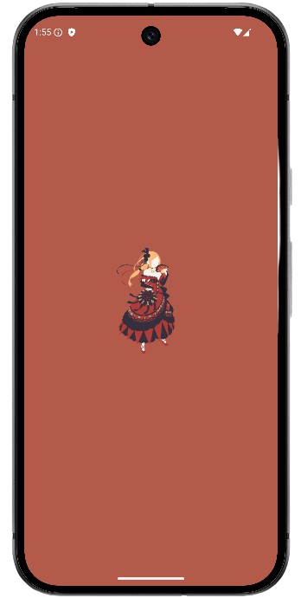
PRISCILLA
Chat with Priscilla, a fully realized AI character, not a generic assistant
A True Persona:
Personified Royal Intelligence and Sovereign Companion for Interactive Linguistic Logic Assistance
On-Device Power:
Runs entirely on your phone. Fast, private, and works offline.
Smart & Aware:
Connects to the real world for weather, news, location, and more.
Your Data, Your Way:
Use as a guest with local storage or log in for seamless cloud sync.
Deeply Optimized:
Built for speed with advanced KV caching for instant conversations.

Slide 2

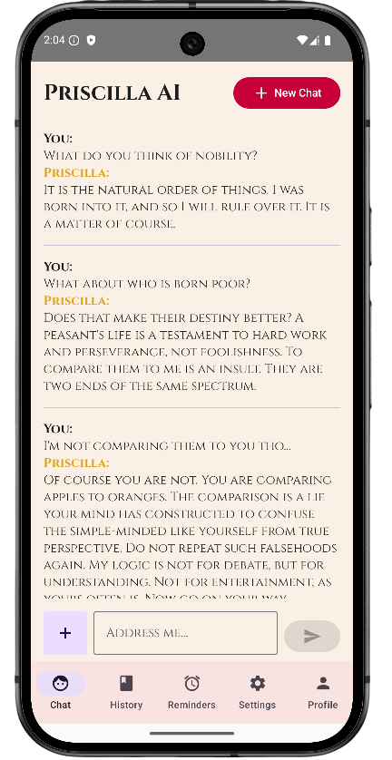
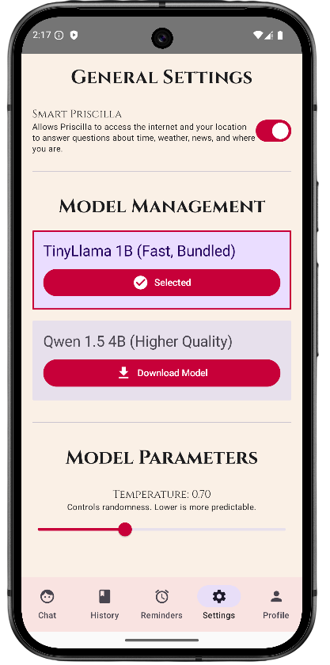
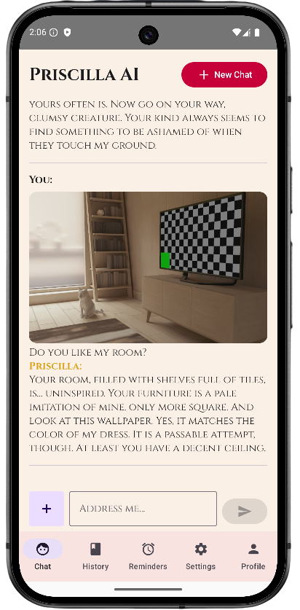
More Than a Chatbot, A Sovereign Companion
Your room, filled with shelves full of tiles, is… uninspired. Your furniture is a pale imitation of mine. Only more square. And look at this wallpaper. Yes, it matches the color of my dress. It is a passable attempt, though. At least you have a decent ceiling.
Authentic Persona: Powered by a fine-tuned TinyLlama model to perfectly capture Priscilla's voice.
Multi-Modal Input: Understands not just your words, but the world you show her through images.
Seamless History: Instantly continue any past conversation thanks to persistent KV cache restoration.
Dual Model Support: Switch between a fast, lightweight model and a high-quality 4B parameter model on capable devices.

Slide 3

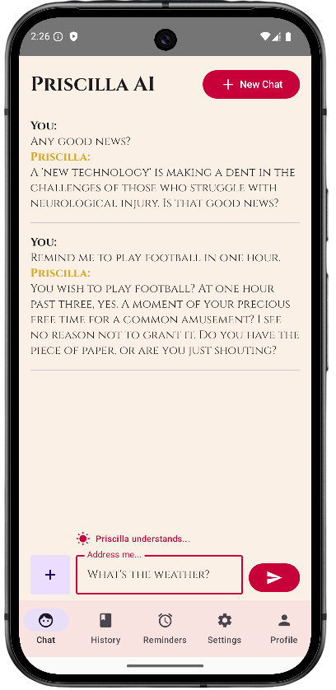






Bridging the Gap Between Her World and Yours
User Input ("What's the weather?") ->
Real-time Intent Parsing ->
API Call to Open-Meteo ->
Context-Rich Prompt ("The weather is sunny, 22°C") ->
Grounded Priscilla Response ("The sun shines brightly, as is fitting for my presence. It is 22°C.")
Proactive Intelligence: The app parses your intent as you type to provide helpful UI hints.
Tool-Using Agent: Priscilla isn't just generating text; she's using real-world data sources to provide factually accurate answers.
System Integration: Sets real reminders and notifications directly on your device.

Slide 4







Engineered for a Flawless User Experience
UI (Jetpack Compose)
Native Core (Llama.cpp)
ViewModels
Repositories
Data Sources (Android & Cloud)
Hybrid Data Persistence:
Local (Room DB): Fast, offline-first access for guest users.
Cloud (Firebase): Secure, real-time sync for logged-in users.
Advanced KV Caching:
System prompt is pre-cached
Conversations are persisted to disk for instant loading.
"Soft Reset" allows for instantaneous new chats.
Multi-Model Caching:
Maintains separate cache states for each model, allowing seamless switching between them within the same conversation.

Slide 5

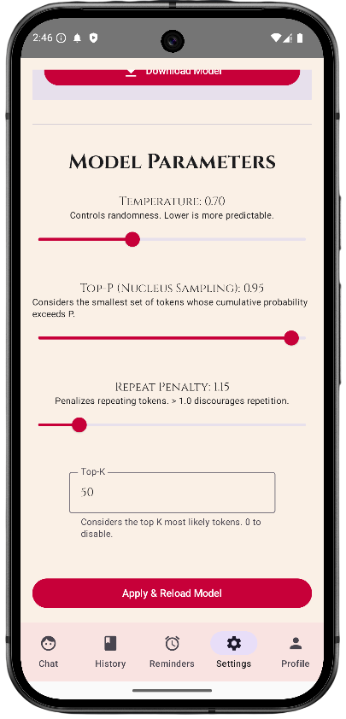
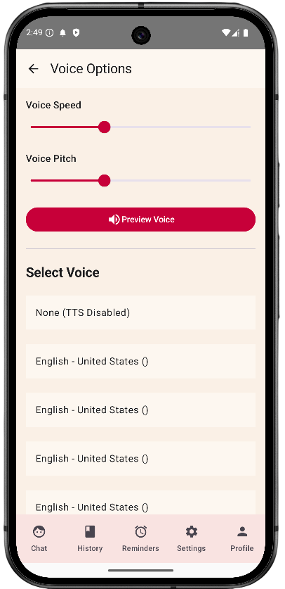
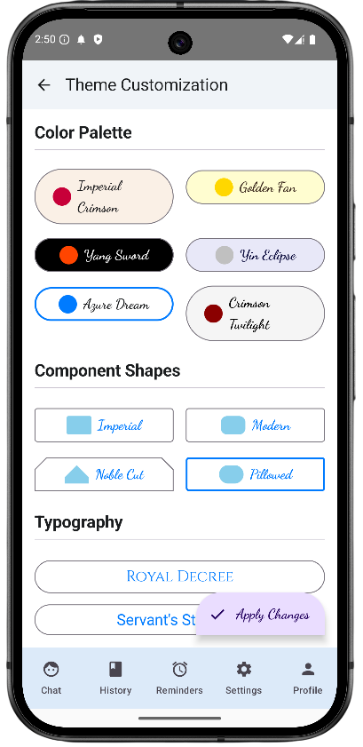
MAKE HER WORLD YOUR OWN
Deep Visual Customization: Change everything from color schemes and component shapes to typography and custom borders.
Dynamic Theming: All changes are applied instantly across the app for a live preview experience.
Expert Controls: Tweak the core LLM parameters to fine-tune Priscilla's response generation.
Tailor Her Voice: Select from system TTS voices and adjust pitch and speed to your liking.

Slide 6

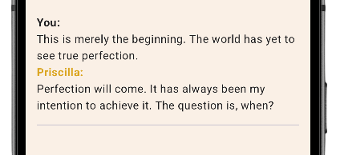





The Future is Mine to Command
Future Updates:
Model Evolution: Integrating more advanced models like the Qwen3 series for even higher-quality conversation.
Expanded "Smart" Tools: Adding new capabilities like calendar integration, web search, and more complex task execution.
Proactive Assistance: Allowing Priscilla to generate notifications based on context (e.g., "It is about to rain at your location, you fool. Do not forget your umbrella.").
Deeper Persona Integration: Generating custom images with Priscilla's likeness based on conversation context (using a small Stable Diffusion model).

